Slide 1
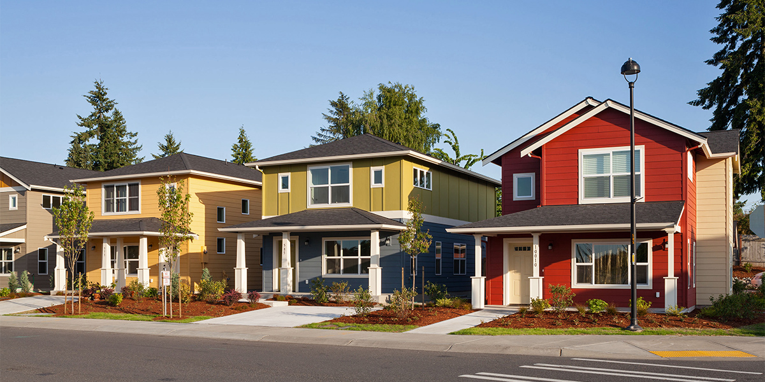
KING COUNTY HOUSING PROJECT

Slide 2
BACKGROUND
Business Problem
The client wants to create a successful platform for buying and selling houses in King County.
Accurate estimates of house prices are crucial for both buyers and sellers.
The platform needs a model that can infer the most important features that determine house prices in King County.
The model needs to be trained on data that accurately represents the real estate market in King County.
The model can be integrated into the platform to provide buyers and sellers with accurate estimates of house prices.

Slide 3

Project analysis slide 2
KEY OBJECTIVES
To identify the key features that significantly influence house prices in King County
To develop a model that accurately estimates house prices based on the identified features.
To evaluate the performance of the developed model in estimating house prices in King County.

Slide 4
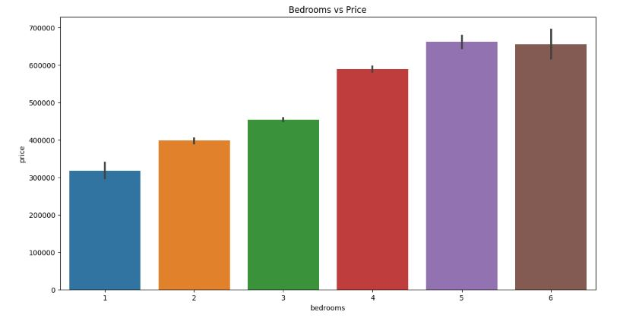
DATA EXPLORATION
1. Number of bedrooms
This visualization makes it very clear that as the number of bedrooms increase, so too does the price of the house.

Slide 5
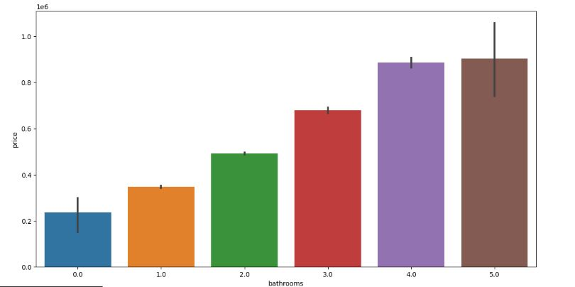
DATA EXPLORATION
2. Number of bathrooms
This visualization shows that as the number of bathrooms increase, so too does the price of the house.

Slide 6
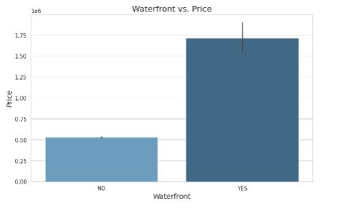
DATA EXPLORATION
3. Waterfront Feature
This visualization helps us to see the impact of the waterfront on the price of the house. The boxplot shows that houses with waterfront tend to have higher prices compared to houses without

Slide 7
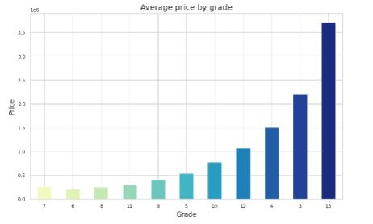
DATA EXPLORATION
4. Grade Feature
From this, we can see that as the grade of the house increases so does the sales price.
The average price of a house with a grade of 13 is the highest
The average price of a house with a grade of 3 is the lowest

Slide 8
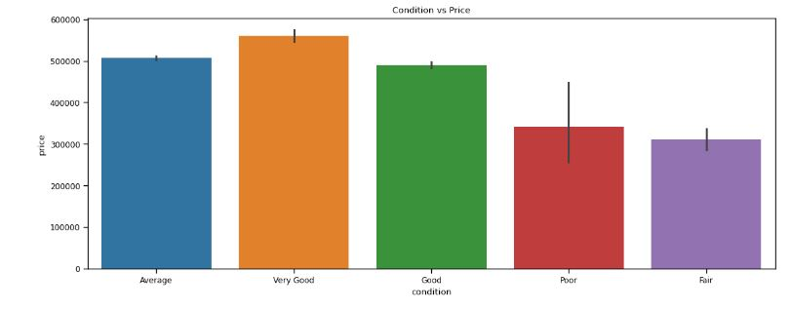
DATA EXPLORATION
5. Condition of house
From this, we can see that price increases as the condition of the house increases
However, it appears that houses in poor condition are priced higher than those in fair condition

Slide 9
Project analysis slide 5
Data Models
1. View of Linear relationship
There is a positive linear relationship between the price and "sft_living" and "sqft_above".
There is no linear relationship between price and "bathrooms" and "bedrooms

Slide 10
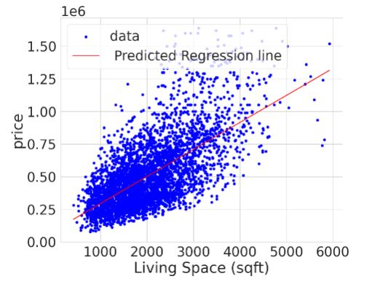
Project analysis slide 5
Data Models
2. Linear Regression: Price and Living Space
R-squared: 0.438
p_value: 0
Interpretation: The r-squared value, 0.438, shows that the model can account for about 43.8% of the variability of price around its mean.
This figure shows positive coefficients meaning that as the value of the independent variable increases, the mean of the dependent variable also increases

Slide 11
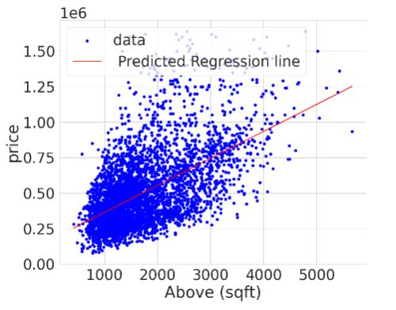
Project analysis slide 5
Data Models
2. Linear Regression: Price and Above sqft(bedrooms + bathrooms + sqft_living + sqft_lot + waterfront)
R-squared: 0.461
p_value: 0
The r-squared value, 0.461, shows that the model can account for about 46% of the variability of price around its mean..
This figure shows positive coefficients meaning that as the value of the independent variable increases, the mean of the dependent variable also increases

Slide 12
Project analysis slide 10
CONCLUSION
The price per sqft living and sqft above ranges from 200 dollars to 300 dollars.
Most houses in King County had 2 bathrooms and 3 bedrooms. The houses with more bathrooms and bedrooms had the highest prices.
In King County most houses were in an average condition and the houses with a very good condition had the highest prices.
Most of the houses had no waterfront and no view, however, the houses with a waterfront and a view had the highest prices.
The multiple linear regression model is better than the two simple regression models as it had a higher R squared value. This shows that categorical variables had a positive effect on the prices as illustrated in the univariate analysis.

Slide 13
RECOMMENDATIONS
The real estate agency should review the sqft of the living space/ the ground above the basement when setting their house prices as there is a linear relationship between these variables.
Factors like bathrooms, bedrooms, having a waterfront and an excellent view have a positive effect on the house prices.
Lastly, the house prices seemed to have increased in 2015 they should therefore consider inflation when setting house prices in the future.

Slide 14
Thank You

